Slide 1


Supply Chain Management
Milestone: 2
By: Shubham Dandak

Slide 2

Agenda
Introduction
Dependent and independent variables
Correlation among different variables
Power BI Dashboard
Summary of Hypothesis Testing

Slide 3

Introduction
In this milestone we are intended to find relationship between dependent and independent variables. I have used Pearson method to find p values and correlation among dependent and independent variables.

Slide 4
Dependent and independent variables

Slide 5

Independent variables
1. Warehouse ID
2. Warehouse Manager ID
3. Location type
4. Warehouse Capacity Size
5. Zone
6. Warehouse regional zone
7. Number of refilling request in last 3 months
8. Transport issues in last one year
9. Competitors in market
10. Retail shop number
11. Warehouse owner type
12. Distributor number
13. Flood impacted
14. Flood proof
15. Electric supply
16. Distance from hub
17. Workers number
18. Warehouse establishment year
19. Storage issues reported in l3m
20. Temperature regulation mechanism
21. Approved warehouse govt certificate
22. Warehouse breakdown reported in l3m
Dependent variable
Product weight tonnes

Slide 6
Relation among dependent and independent variable

Slide 7
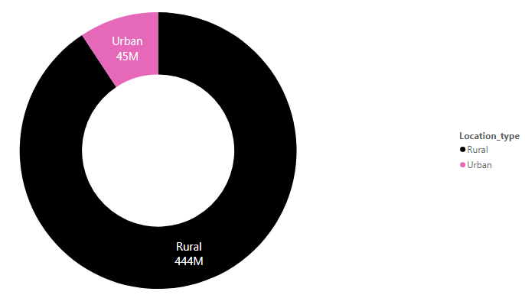
Feature | Location type
H0 | Location has significant impact on product weight tonne
Ha | Location does not have significant impact
p-value | 2.1562766876026297e-28
Response | Rejecting null Hypothesis since p<0.05

Slide 8
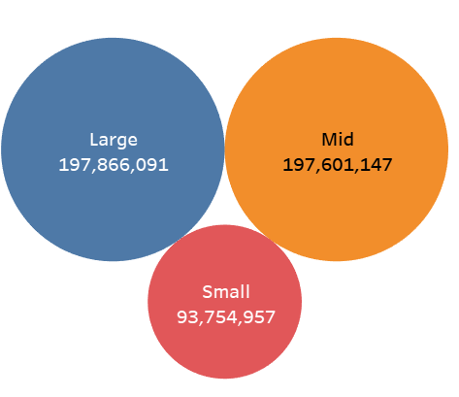
Feature | Warehouse capacity size
H0 | Warehouse capacity size has significant impact on product weight tonne
Ha | Warehouse capacity size does not have significant impact
p-value | 0.6588
Response | Accepting null Hypothesis since p>0.05

Slide 9
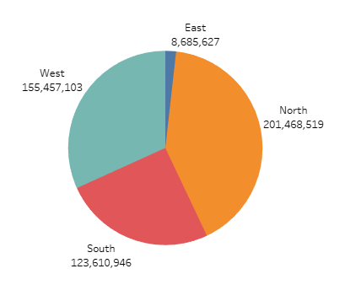
Feature | Zone
H0 | Zone has significant impact on product weight tonne
Ha | Zone does not have significant impact
p-value | 0.1853
Response | Accepting null Hypothesis since p>0.05

Slide 10
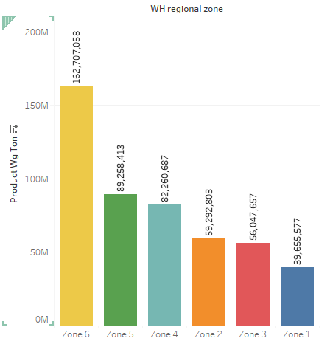
Feature | Warehouse regional zone
H0 | Warehouse regional zone has significant impact on product weight tonne
Ha | Warehouse regional zone does not have significant impact
p-value | 0.9897
Response | Accepting null Hypothesis since p>0.05

Slide 11
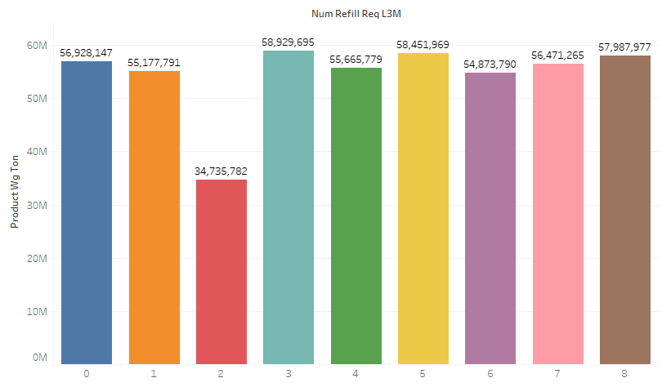
Feature | Number of filling request in last 3 months
H0 | Number of filling request in last 3 months has significant impact on product weight tonne
Ha | Number of filling request in last 3 months does not have significant impact
p-value | 0.9198
Response | Accepting null Hypothesis since p>0.05

Slide 12
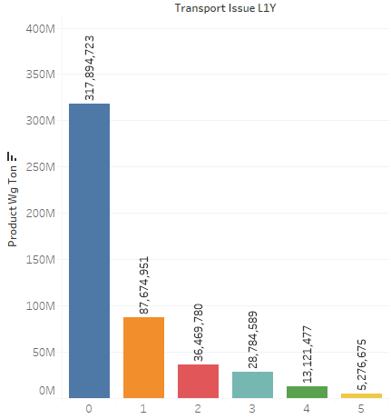
Feature | Transport issues in last one year
H0 | Transport issues in last one year has significant impact on product weight tonne
Ha | Transport issues in last one year does not have significant impact
p-value | 3.9426614757023443e-153
Response | Rejecting null Hypothesis since p<0.05

Slide 13
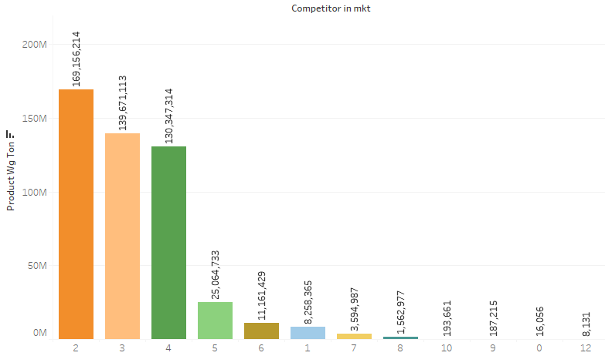
Feature | Competitors in market
H0 | Competitors in market has significant impact on product weight tonne
Ha | Competitors in market does not have significant impact
p-value | 0.2784
Response | Accepting null Hypothesis since p>0.05

Slide 14
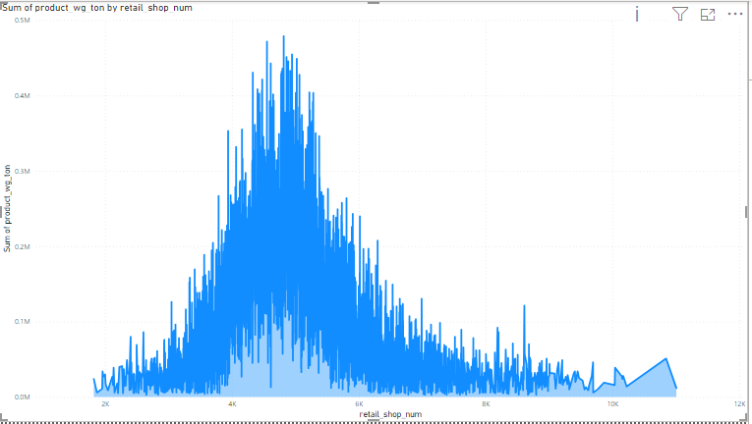
Feature | Retail shop numbers
H0 | Retail shop numbers has significant impact on product weight tonne
Ha | Retail shop numbers does not have significant impact
p-value | 0.3125
Response | Accepting null Hypothesis since p>0.05

Slide 15
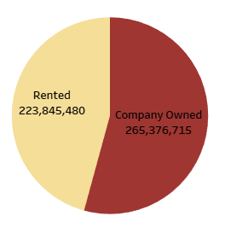
Feature | Warehouse owner type
H0 | Warehouse owner type has significant impact on product weight tonne
Ha | Warehouse owner type does not have significant impact
p-value | 0.6115
Response | Accepting null Hypothesis since p>0.05

Slide 16
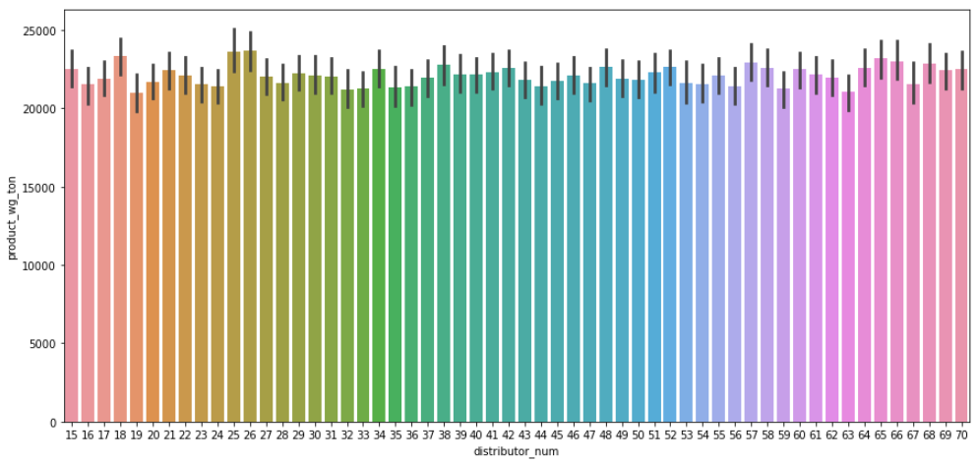
Feature | Distributor num
H0 | Distributor num has significant impact on product weight tonne
Ha | Distributor num does not have significant impact
p-value | 0.4440
Response | Accepting null Hypothesis since p>0.05

Slide 17
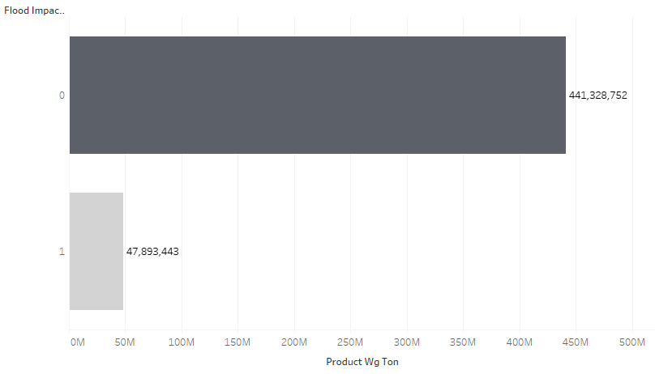
Feature | Flood impacted
H0 | Flood impacted has significant impact on product weight tonne
Ha | Flood impacted does not have significant impact
p-value | 0.4518
Response | Accepting null Hypothesis since p>0.05

Slide 18
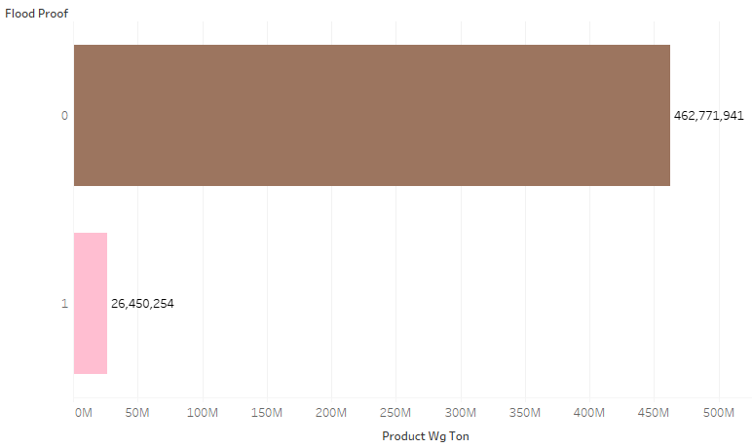
Feature | Flood proof
H0 | Flood proof has significant impact on product weight tonne
Ha | Flood proof does not have significant impact
p-value | 0.5955
Response | Accepting null Hypothesis since p>0.05

Slide 19
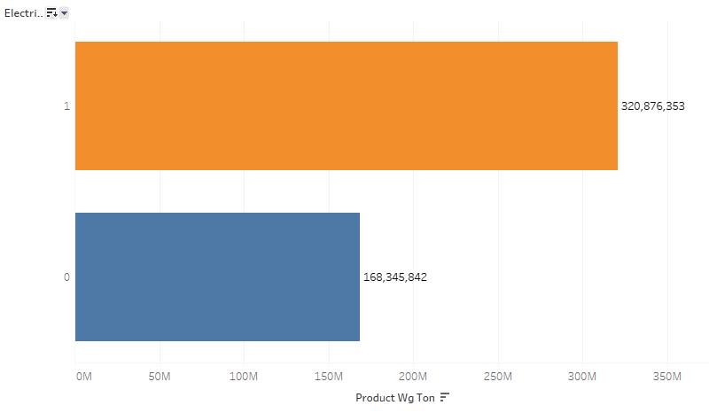
Feature | Electric supply
H0 | Electric supply has significant impact on product weight tonne
Ha | Electric supply does not have significant impact
p-value | 0.9140
Response | Accepting null Hypothesis since p>0.05

Slide 20
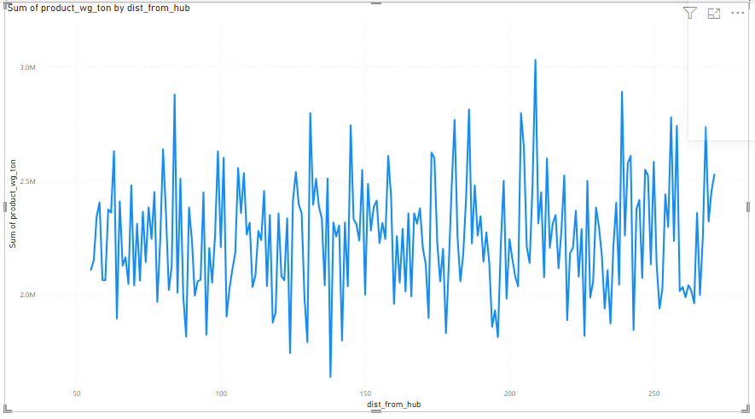
Feature | Distance from hub
H0 | Distance from hub has significant impact on product weight tonne
Ha | Distance from hub does not have significant impact
p-value | 0.3687
Response | Accepting null Hypothesis since p>0.05

Slide 21
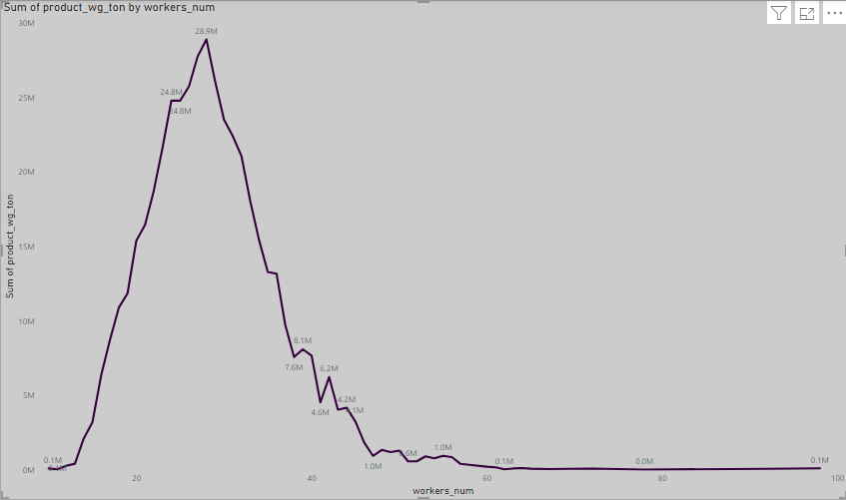
Feature | Workers number
H0 | Workers number has significant impact on product weight tonne
Ha | Workers number does not have significant impact
p-value | 0.6546
Response | Accepting null Hypothesis since p>0.05

Slide 22
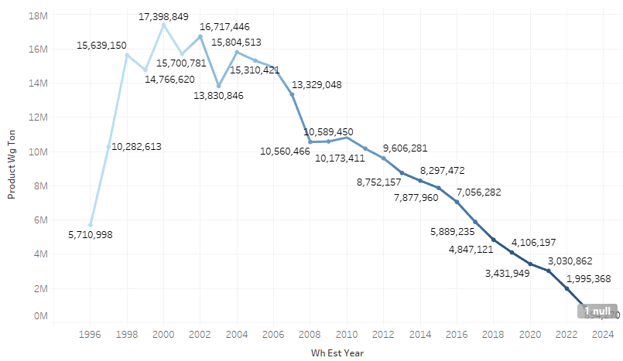
Feature | Warehouse establishment year
H0 | warehouse establishment year has significant impact on product weight tonne
Ha | warehouse establishment year does not have significant impact
p-value | 0.0
Response | Rejecting null Hypothesis since p<0.05

Slide 23
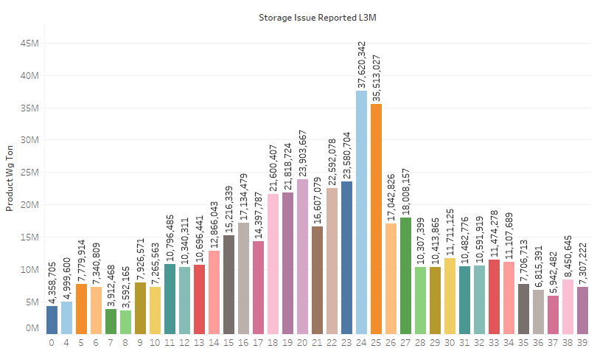
Feature | Storage issue reported in last 3 months
H0 | Storage issue reported in last 3 months has significant impact on product weight tonne
Ha | Storage issue reported in last 3 months does not have significant impact
p-value | 0.000
Response | Rejecting null Hypothesis since p<0.05

Slide 24
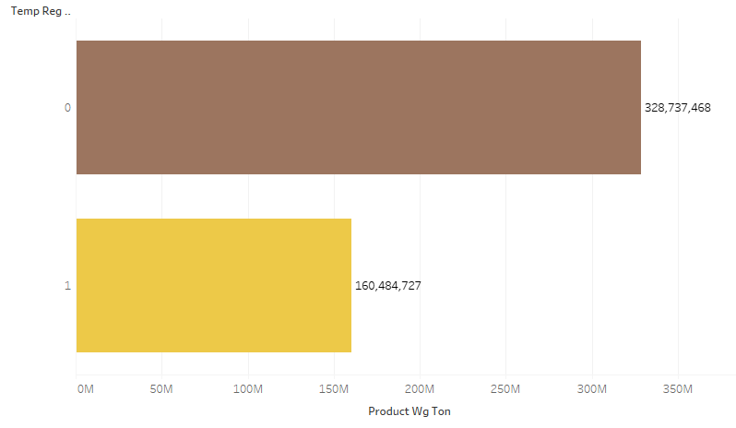
Feature | Temperature regulation mechanism
H0 | Temperature regulation mechanism has significant impact on product weight tonne
Ha | Temperature regulation mechanism does not have significant impact
p-value | 7.768156123626193e-49
Response | Rejecting null Hypothesis since p<0.05

Slide 25
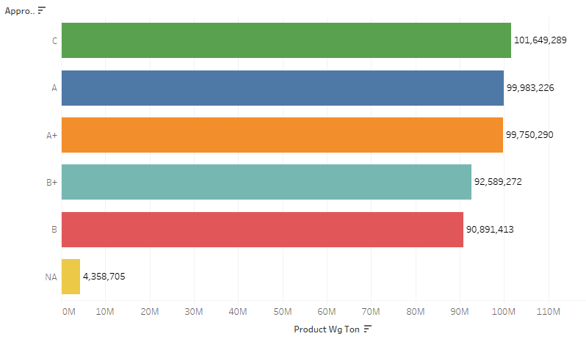
Feature | Approval from the government
H0 | Approval from the government has significant impact on product weight tonne
Ha | Approval from the government does not have significant impact
p-value | 7.542961087692836e-255
Response | Rejecting null Hypothesis since p<0.05

Slide 26
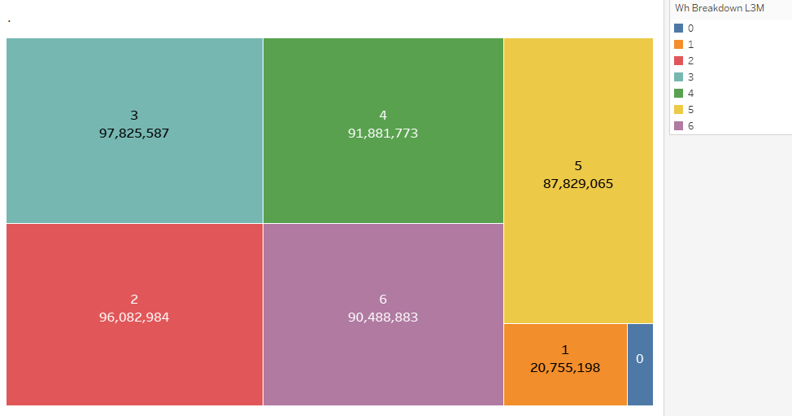
Feature | Warehouse breakdown in last 3 months
H0 | Warehouse breakdown in last 3 months has significant impact on product weight tonne
Ha | Warehouse breakdown in last 3 months does not have significant impact
p-value | 0.0
Response | Rejecting null Hypothesis since p<0.05

Slide 27
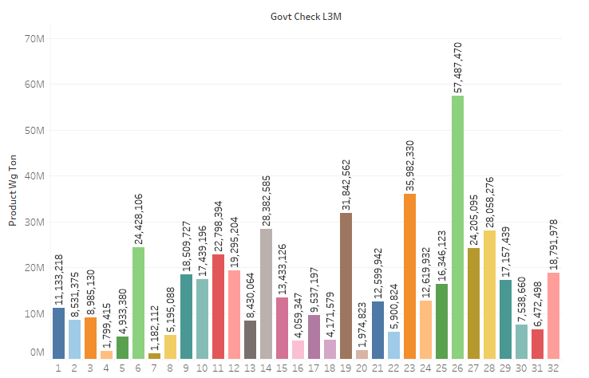
Feature | Government check in last 3 month
H0 | Government check in last 3 month has significant impact on product weight tonne
Ha | Government check in last 3 month does not have significant impact
p-value | 0.07467
Response | Accepting null Hypothesis since p>0.05

Slide 28

Power Bi dashboard

Slide 29
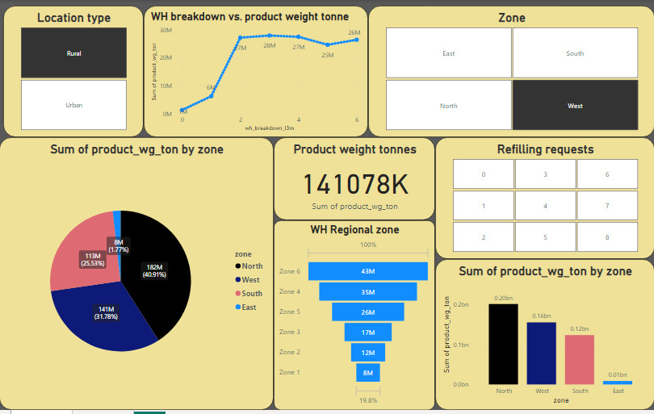

Slide 30
Summary of hypothesis testing

Slide 31
Independent feature | Dependent feature | P-Value | Null Hypothesis | Alternate hypothesis
1. Location type | Product weight tonne | 2.15627e-28 | × | ✓
2. Warehouse Capacity Size | Product weight tonne | 0.6588 | ✓ | ×
3. Zone | Product weight tonne | 0.1853 | ✓ | ×
4. Warehouse regional zone | Product weight tonne | 0.9897 | ✓ | ×
5. Number of refilling request in last 3 months | Product weight tonne | 0.9198 | ✓ | ×
6. Transport issues in last one year | Product weight tonne | 3.9426e-153 | × | ✓
7. Competitors in market | Product weight tonne | 0.2784 | ✓ | ×
8. Retail shop number | Product weight tonne | 0.3125 | ✓ | ×
9. Warehouse owner type | Product weight tonne | 0.6115 | ✓ | ×
10. Distributor number | Product weight tonne | 0.4440 | ✓ | ×

Slide 32
Independent feature | Dependent feature | P-Value | Null Hypothesis | Alternate hypothesis
11. Flood impacted | Product weight tonne | 0.4518 | ✓ | ×
12. Flood proof | Product weight tonne | 0.5955 | ✓ | ×
13. Electric supply | Product weight tonne | 0.9140 | ✓ | ×
14. Distance from hub | Product weight tonne | 0.3687 | ✓ | ×
15. Workers number | Product weight tonne | 0.6546 | ✓ | ×
16. Warehouse establishment year | Product weight tonne | 0.0 | × | ✓
17. Storage issues reported in l3m | Product weight tonne | 0.000 | × | ✓
18. Temperature regulation mechanism | Product weight tonne | 7.768e-49 | × | ✓
19. Approved warehouse govt certificate | Product weight tonne | 7.54e-255 | × | ✓
20. Warehouse breakdown reported in l3m | Product weight tonne | 0.0 | × | ✓
21. Government check in last 3 month | Product weight tonne | 0.07467 | ✓ | ×

Slide 33
Thank you
Shubham Dandak
shubhdandak@gmail.com
https://github.com/shubh4515

